Slide 1


Data Analysis of Accommodation scenario in Munich
Navin Kumar Trivedi
19th May, 2020

Slide 2

Why analyze accommodation scenario in Munich?

Slide 3
Every year there are a huge number of aspirants joining numerous courses in various institutes of Germany, however not many student-dorms or hostels to accommodate them all.
The accommodation in Germany, especially for international students, is really a huge problem .
This project aims to analyze the available data and produce a suitable report for the prospective students desiring to pursue their studies in Munich, Germany.
All the prospective students who would be interested to pursue their studies in Munich, as well as those who have already arrived but have yet not found an accommodation would be benefitted

Slide 4
Data acquisition and cleaning
Most of the relevant data related with the student-dorms in Munich can be obtained from
https://navin3011.github.io/Wartezeiten_Mietpreislisteenglisch-converted.csv
I have also used Foursquare location data from http://www.foursquare.com/
to cluster and segment the dorm locations.
Data binning for basic rents into 4 categories
Data wrangling and cleaning of various missing data and changing the datatypes to the required format.

Slide 5
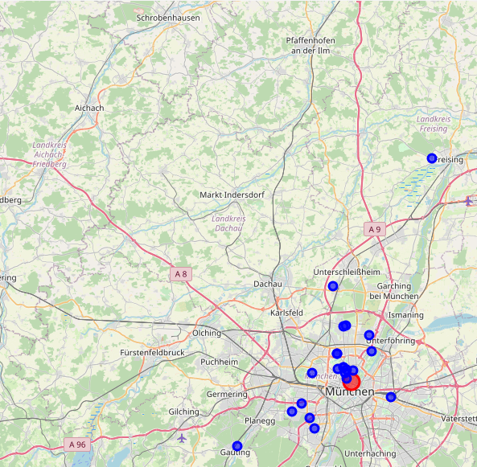
Clustering & Segmenting the Munich Central
Using the Foursquare Location Data. I first chose to map all the available student dorms in Munich to depict the clear view of their locations within the radius of 50km and using the search query “studentenwohnheim” meaning student-dorm in German

Slide 6
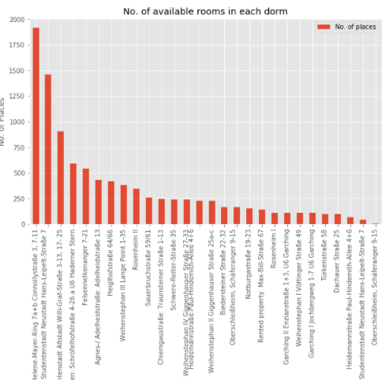
Observing the No. of Rooms available
Prospective students should definitely apply for Top 3 dorms i.e., Olympic Village, Studentenstadt Neustadt, and Studentenstadt Altstadt to increase their chances of allocation

Slide 7
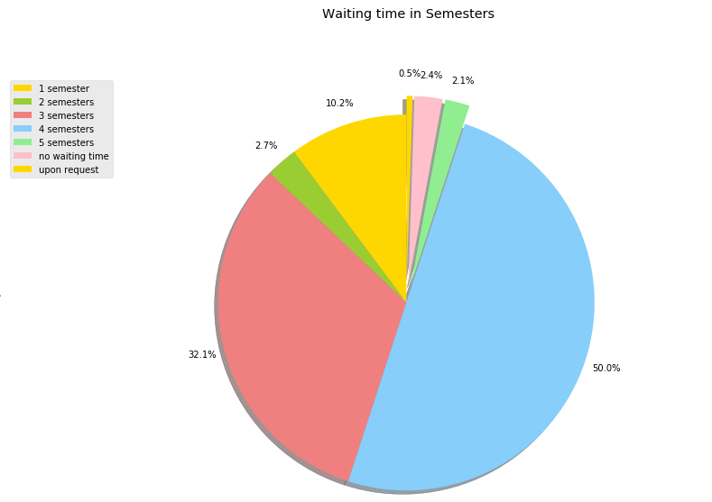
The ordeal of Waiting period
One can clearly infer from the pie chart the ordeal of the waiting period for the students. Almost 50% of the student dorms have the waiting period of 4 semesters.

Slide 8
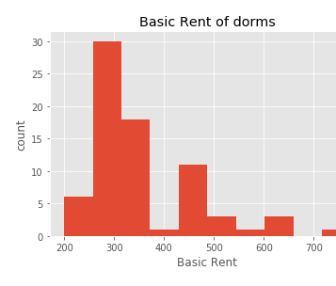
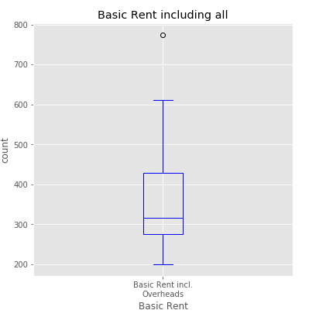
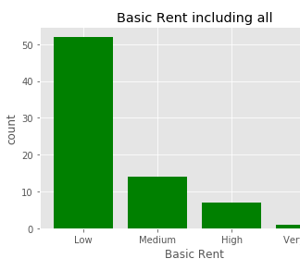
Money is always a problem
The bar-chart has been obtained by data binning of rent list into 4 different categories, showing that the basic rent of most of the dorms fall under low rent category.
Similarly, the histogram on the right provides the exact detail of dorms with their rent.
The box plot makes it very easy and simple to get the maximum information from a single plot. It shows that the minimum rent is around 270€, and median rent being around 330€. However, there is one outlier at around 780€.

Slide 9
Conclusions
Analyzed the various factors associated with the chances of a student getting a student-dorm in Munich
Analyzed the relationship between the waiting period of the dorm with the number of dorms available, and visualized the data using various python inbuilt data visualization tools
This analysis could be useful to the aspiring students willing to study in Munich with a little knowledge of accommodation scenario here.
Finally, the cost of living in Munich surges with the increase in room rent, so choosing the dorm wisely could save finance to a great extent.

Slide 10

Thank You

